Slide 1
Network Anomaly Detection using MapReduce
-
Mehal Chaudhari, Nagaprasad Natarajaurs, Suruchi Singh

Slide 2
Motivations
At present, many anomaly detection models are proposed by researchers such as Blacklisting matching, statistics rules and machine learning and several tools. Machine learning has the best performance of all these methods, however with the huge increase of traffic data, the efficiency of machine learning is also a bottleneck because of its complex calculation.
MapReduce is a distributed programming model which can handle massive data concurrently in a large computer cluster. This makes it efficient to detect an anomaly in the network in real time. Since, the network has a large amount of data to be processed, we decided to use MapReduce to detect anomalies observing inconsistent data from a given set of data.

Slide 3
Related works
In the IEEE paper, A policy Anomaly Detection Algorithm Based on MapReduce, the authors discuss the need to define some security strategies(rules for computer network access) to control the data packet for the network devices like the firewall.
The security strategy is combined with the fields - <id, protocol, sourceIP, sourcePort, targetIP, targetPort, action> where ‘id’ is the unique identifier. When the data packet reach the network devices, it will check the rules according to the strategy list. If the head of the data packet matches the range of IP address then it will allow the data packet to go through else the data packet will be rejected.

Slide 4
Problem Description
We have a data set which contains details about each event which occurred in the network. Event details include user, event description, timestamp, location, IP address & device.
Each anomaly is assigned a factor based on how much deviation it causes from the normal operation of the network.
Anomalies in this case can be:
The event is arising from a VPN or a proxy.
The geo-location determined using the IP address is different from the location of the device.

Slide 5
Problem Description
There was a change in the user’s device.
…
The event’s anomaly is calculated using each anomaly’s factor which is present in the event.
If the events anomaly is greater than the threshold set by the administrator of the network, the event is red flagged.
The threshold varies based on the security levels required by the administrator.

Slide 6
Design/Proposed methods
Detect whether the event has location spoofed
Map related events to each event
Using related events, build a user profile
Determine event’s anomaly based on how much it deviates from the user’s profile
Finally red flag it if its greater than the set anomaly threshold

Slide 7
Detect location spoofing
In Mapper stage, map every event using IP as the key
In Reducer stage, flag or not flag every event for location spoofing
Location spoofed if
The users are greater than average household count for any given IP
The IP location’s is different from the determined coarse
Coarse location for the given IP is determined based on the locations of all events

Slide 8
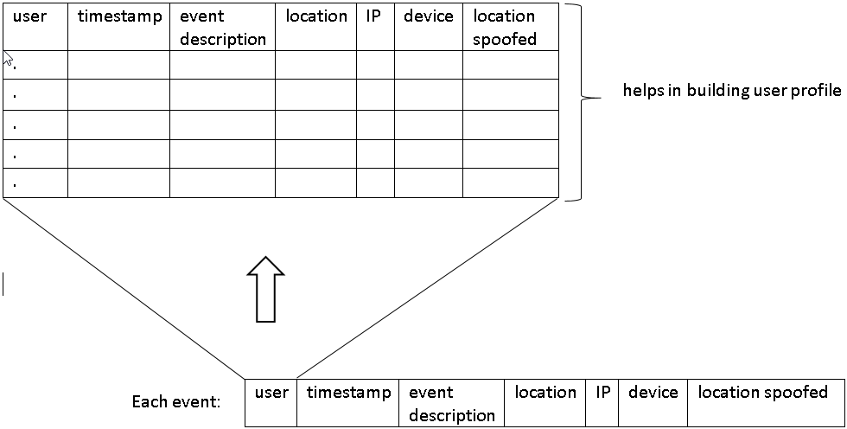
User profiling and anomaly detection
For every event, map all the previous events which belong to that user

Slide 9
User profiling and anomaly detection
Determine all the defined anomalies present in the event
Calculate the total anomaly factor for the event
Ex: If location spoofing is detected for the event, then anomaly factor is 0.35
If user had authentication failure as prior event, then anomaly factor is 0.40
If event has both (location spoofing & authentication failure), then anomaly factory is 0.75
If calculated anomaly factor is greater than the threshold, flag the event for administrator’s review

Slide 10
Work in progress
Simulations/ Proposed methods
Analysis for the results

